Slide 1
Change Name
Company Name
Date

Slide 2
Change Baseline Info
Type of Change (Check all that apply):
Alternate specified material
Change in product processing
Tool Move/supplier plant floor change – no address change
Capacity improvement
Change in manufacturing or shipping location
Tooling refurbishment
Sub-tier change
Material source change
Outsource of process to sub-tier
Reason for Change (Check all that apply):
Improve incoming quality or warranty
Improve supply chain logistics
Improve capacity or throughput
Reduce cost
Urgent situation, Emergency, or containment action
Other
Other Reasoning:

Slide 3
Change Statement
Opportunity or Problem Statement
  The current state requiring a change to be made. This statement shall include the Solero Technologies and supplier part number and revision plus a picture of each part requiring the change (use of an additional slide may be needed if there are multiple parts impacted)
Description of the Change
  The need or request to realize an opportunity or mitigate the risk of a problem. In this section please make sure to note if this is a change in manufacturing location and if the change is reversable.
Quantitative Benefits of this change to Solero Technologies Water Valley
  Measurable outcomes that will benefit Solero Technologies Water Valley

Slide 4
Risk Assessment
Low Risk
High Risk
Explain Risk Assessment
Use of DFMEA and PFMEA to explain risk areas and controls is appropriate.
Other tools can be used to explain the risk in a quantifiable way.

Slide 5
Cost Savings to Solero
Numbers and explanation on how this is a benefit to Solero
Processing changes at Solero Technologies and Solero’s customer is not a zero-cost activity. To facilitate this change please present the cost savings benefits that Solero will receive to process this change. Changes that do not have a cost savings analysis may be rejected without further review.

Slide 6
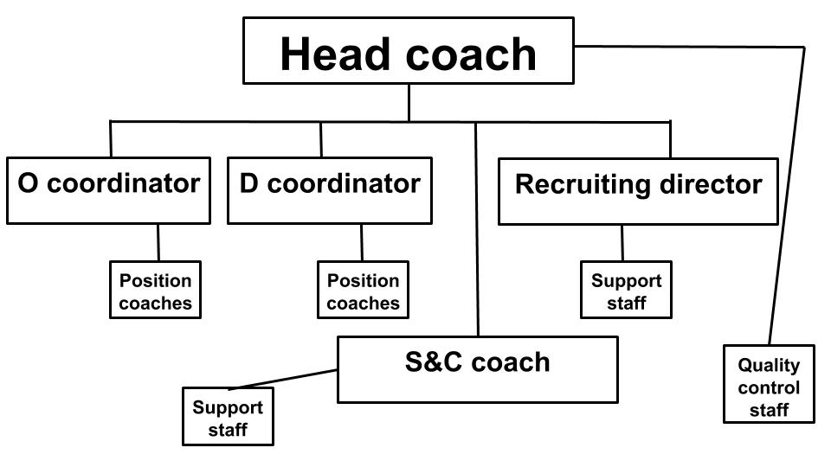
Supplier Change Team
Supply details about who the contacts will be for the distinct aspects of the change. An organizational chart showing escalation paths shall be part of the details presented.

Slide 7
Timing Plan
Must include all these milestones
    Banking Plan
      A banking plan is required to ensure ongoing fulfillment of orders; the bank must be long enough to cover the supplier needs plus a minimum 12 weeks after PPAP submission to Solero Technologies. A larger bank may be needed based on Solero Technologies Customer validation needs. This will be negotiated with the Solero Technologies GSM and Supplier
    Tooling and Equipment timing
    Appearance Approval (AAR)
    PFMEA Review
    Control Plan review
    Planned Product Trail Run and capacity verification
    Work instructions
    DV & PV Testing
    Capability studies for any features identified on GSM-F027 (before and after change)
    Sub-tier evaluation
    PPAP Submission date to Solero Technologies
    Dimensional approval/CMM Layout
    First Ship Date/SOP

Slide 8
Details of the Bank Plan
Must include information on these topics
  Packaging plan for part preservation
  Plan to insure that defects are prevented,
  How will FIFO is maintained
  Reaction plan if any quality issues are found during the use of the bank

Slide 9
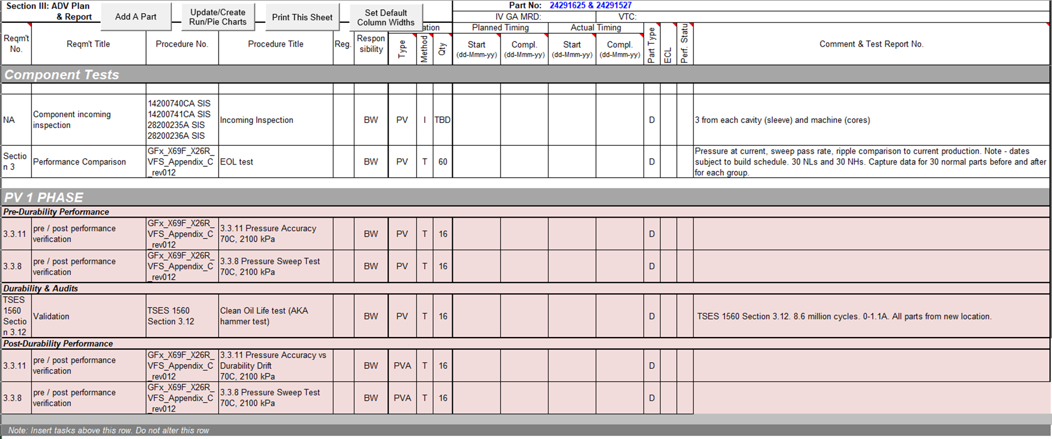
Validation Plan
This slide should include details about the DVP/PVP&R including dimensional layout, material analysis, capability analysis, and performance or functional testing that will be done to verify the change.
  For changes like Line Moves, Plant Moves, Machine upgrades, tool replacement or any other changes that can that have a before and after state that must be compared, a list of dimensions in which capability will be compared must be included in the plan. At minimum, all design record requirements that have a Special Characteristic Rating (critical characteristic), defined as needing statistical control, or pass-through characteristics identified during the establishment of the GSM-F024 shall be included in this listing
  Any products produced after the change shall show equal or better conformance, capability, and performance then product produced before the change.

Slide 10
EPC Plan
Please explain how you will protect Solero Technologies with use of EPC plan.
This slide shall have an outline of the proposed EPC plan that will be used to verify the effectiveness of the change and protect Solero Technologies from any adverse impact of the change and ensure a safe launch.
Use GSMF-018 to communicate plan and commitment.

Slide 11
Sub-Tier Evaluation
please describe the method that will be to evaluate the sub-tier process and conformance to Solero Technologies' requirements.
Tools such as VDA audit, CQI, TFC, or other risk review tools should be used.

Slide 12
Traceability Plan
Describe how the management of old style and new style parts change point tracking so Solero Technologies can easily identify them within the supply chain.
  Plan shall include labeling per the standard described in Section A of this document.
Explain control method so ensure tracking and segregation of Before Change and After Change materials
Use of the Solero Technologies Water Valley SPECIAL SHIPMENT Format should be noted.

Slide 13
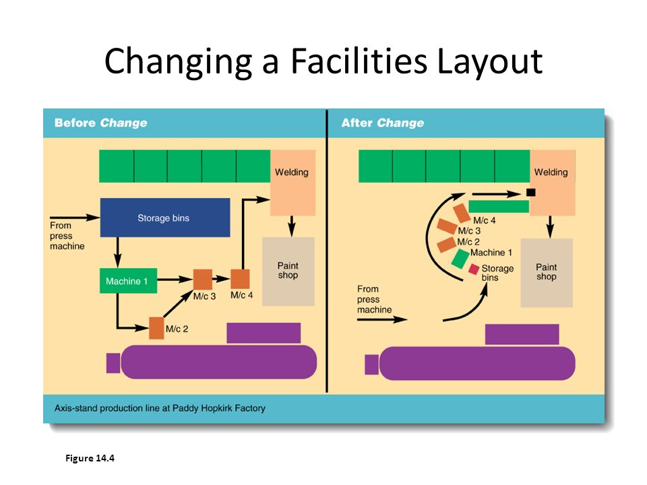
Floor Layout & Process Flow Comparison
A comparison of any planned floor layout and process flow changes shown side-by-side before and after change.

Slide 14
Maintenance Plan
Describe the preventative maintenance plan for new, refurbished, or moved equipment and tooling. How will the plan prevent or detect any issues that could negatively affect Solero Technologies
What changes or improvements need to be made to maintenance plan?

